Slide 1
Xbox Statistics
Xfest
August 23, 2000
Daniel Adam
Lead Program Manager

Slide 2
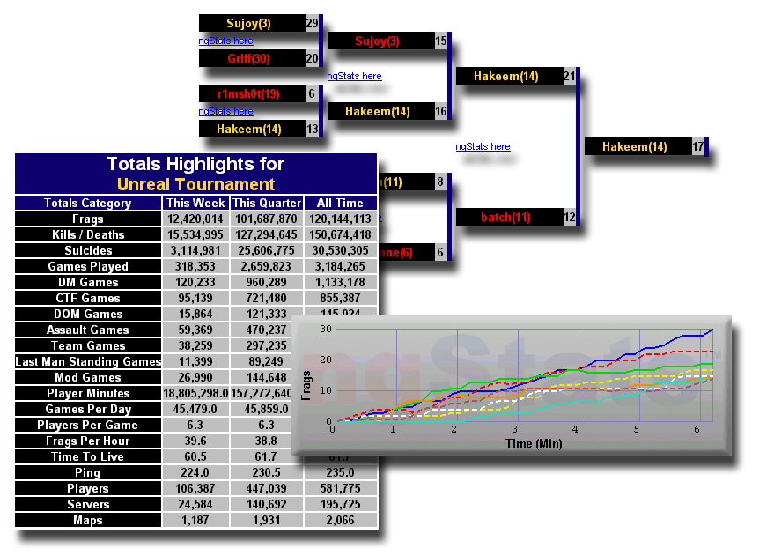
Xbox Statistics
Statistics
Rankings
Match Play

Slide 3
Who Are We?
Background
  We were NetGames USA and OSP Mod Team
    Real-time statistics and rankings
    Automated tournament system
    Proof-of-concept development (OSP)
  Gaming, stats, and competition junkies
Today
  We are the Xbox Statistics Team

Slide 4
Goals
Comprehensive statistics and ranking support; minimal developer time commitment
Statistics, rankings, and matchmaking fully integrated into your titles
  Match play in second version
Seamless in-game experience: statistics and rankings won’t look like an afterthought

Slide 5
Goals
Cheat prevention and security
  If customers can cheat, your online title can’t succeed
Deliver deep customer research and game analysis
  Feedback will help you hone your titles

Slide 6
Xbox Statistics Is…
A set of APIs that gives you access to:
  Game statistics
    Store scores locally and online
    Single and multiplayer game support
  Rankings and ratings
  Integrated with Xbox matchmaking services
  Match play (ladders, tournaments, etc.)

Slide 7
Xbox Statistics Is...
Statistics tool for developers
  Generates code and data structures for statistics and ranking support
  Client and server components; generates all server queries
  You have full control
    Iterative design capabilities; continue modifying as your needs change
  Gives you access to a beta/test site, separate from production
  Fully automated tool
    We are available to answer questions
Samples and templates provided

Slide 8
Data Flow Diagram
Game Logs
Data
Collection
Xbox
Live Game Status
Log Processing
Online
Game
Play
Databases
In-Game Data
Xbox Zone
Servers
Xbox
Xbox Dashboard Pages

Slide 9
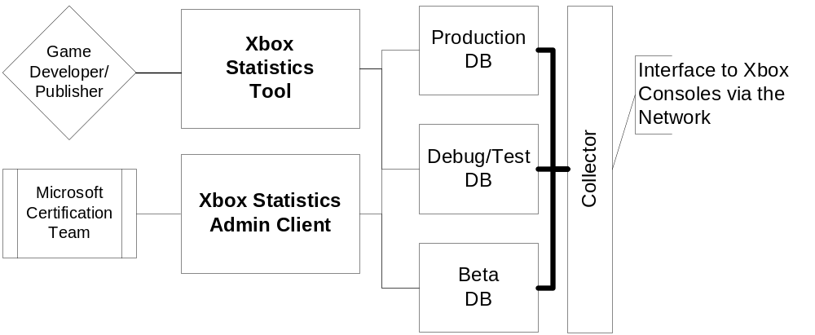
Statistics Tool
Data Flow Diagram

Slide 10
Summary
Please use the feedback form to give us feedback on what you’ve heard!
This talk was given by:
  Daniel Adam, Xbox Statistics
Questions?

